Slide 1
Rate Rule

Slide 2
<RateRuleSettings>
The root element of the rate rules XML file.The <RateRuleSettings> element contains:
<UserRateCondition> elements that define the conditions to match on for conditional and private rates. For example, you can create a conditional rate that matches on the condition of all users in a certain country.
<RateRule> elements that each define a rate rule for reference in a <Rate> in a Transaction message. Each <RateRule> specifies the conditions and UI treatment that construct a conditional or private rate.

Slide 3
The <RateRuleSettings> element appears in the following place in the rate rules XML hierarchy:
+ <RateRuleSettings> + <UserRateCondition> + <RateRule> + <UserRateCondition> + <RateIneligibility> + <RateModification>
Definitions of userRateCondition
Refrence of userRateCondition
OR
They can be defined here inline

Slide 4
The <RateRuleSettings> element uses the following syntax:
Defines one or more conditions that when matched result in conditional or private rates being served.
<?xml version="1.0" encoding="UTF-8"?> <RateRuleSettings> <UserRateCondition id="some_id" op="[all|any|none]"> ... </UserRateCondition> <!-- Required --> <RateRule id="rate_rule_id"> <!-- Required --> <UserRateCondition op="[all|any|none]"> ... </UserRateCondition> </RateRule> </RateRuleSettings>
Defines the matching conditions, modifications, and eligibility for serving a conditional or private rate. Requires an id attribute, which can be referenced in a <Rate> of a Transaction message or in a landing page URL.

Slide 5
Example
<?xml version="1.0" encoding="UTF-8"?> <RateRuleSettings> <UserRateCondition id="mobile"> <UserDeviceType>mobile</UserDeviceType> </UserRateCondition> <RateRule id="mobile"> <!-- Referencing pre-defined conditions is recommended --> <UserRateCondition reference_id="mobile"/> </RateRule> </RateRuleSettings> ----------------------------------------------------------------------------------------------------------------------------------------------------------------------------------------------------------------------------------------------------------------------
<?xml version="1.0" encoding="UTF-8"?> <RateRuleSettings> <UserRateCondition id="us"> <UserCountry>US</UserCountry> </UserRateCondition> <RateRule id="us"> <UserRateCondition reference_id="us"/> </RateRule> </RateRuleSettings>
Reference to userRateCondition defined above
Reference to userRateCondition defined above

Slide 6
<RateRule>
A container for specifying:
Conditions for serving a rate
Modifications, if any, to the price and UI treatment for the rate
Use of hidden UI treatments for private rates
+ <RateRuleSettings> + <UserRateCondition> + <RateRule> + <UserRateCondition> + <RateIneligibility> + <RateModification>

Slide 7
<?xml version="1.0" encoding="UTF-8"?> <RateRuleSettings ...> <UserRateCondition ...> ... </UserRateCondition> <!-- At least one RateRule is required. The id attribute is required --> <RateRule id="rate_rule_id"> <!-- One or more UserRateCondition elements (inline or referenced) are required. --> <UserRateCondition op="[all|any|none]"> // Inline example <Description>user_rate_condition_description</Description> <!-- Uses the member rate visible UI treatment --> <AlwaysEligibleMembershipProgram>program_name</AlwaysEligibleMembershipProgram> <LanguageCode>language_code</LanguageCode> <MaxUsersPercent>20</MaxUsersPercent> // 20% of users <!-- Requires <RateIneligibility> --> <MembershipProgram>program_name</MembershipProgram> <UserRateCondition reference_id="user_rate_condition_id"\> <UserCountry>country_code</UserCountry> <UserDeviceType>[mobile|desktop|tablet]</UserDeviceType> <UserListId>id</UserListId> <UserSignedIn>[true|false]</UserSignedIn> <IsDomestic>[true|false]</IsDomestic> </UserRateCondition> <RateIneligibility> <IneligibilityType>[exact|price_band|existence]</IneligibilityType> <IneligibilityReason>[program_member]</IneligibilityReason> </RateIneligibility> <RateModification> <HotelAmenity>[free_wifi]</HotelAmenity> </RateModification> </RateRule> </RateRuleSettings>
UserRateCondition

Slide 8
Inside slide 7
<UserRateCondition op="[all|any|none]"> // Inline example <Description>user_rate_condition_description</Description> <!-- Uses the member rate visible UI treatment --> <AlwaysEligibleMembershipProgram>program_name</AlwaysEligibleMembershipProgram> <LanguageCode>language_code</LanguageCode> <MaxUsersPercent>20</MaxUsersPercent> // 20% of users <!-- Requires <RateIneligibility> --> <MembershipProgram>program_name</MembershipProgram> <UserRateCondition reference_id="user_rate_condition_id"\> <UserCountry>country_code</UserCountry> <UserDeviceType>[mobile|desktop|tablet]</UserDeviceType> <UserListId>id</UserListId> <UserSignedIn>[true|false]</UserSignedIn> <IsDomestic>[true|false]</IsDomestic> </UserRateCondition>

Slide 9
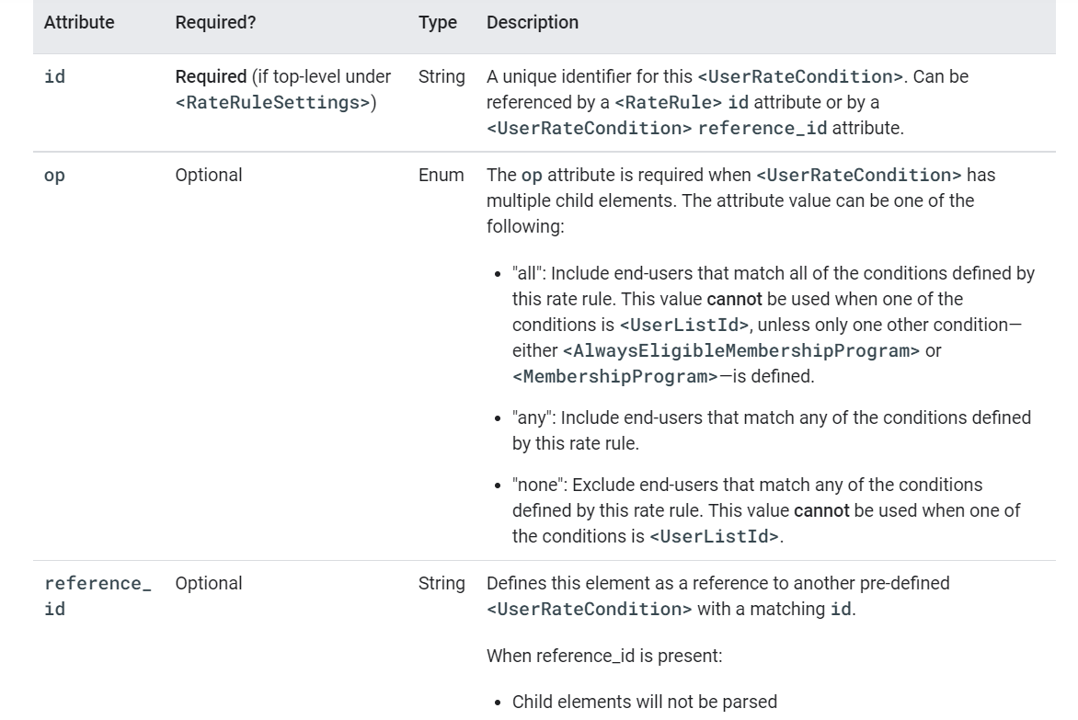
<UserRateCondition> Attributes
show rate to customers matching in this conditions
show rate to customers matching ANY of the conditions
Don’t show rate to customers matching in this conditions

Slide 10
Rate Ineligibility
Indicates how to display the member rate hidden UI treatment. If not included, the member rate hidden UI treatment will not be displayed.
To use <RateIneligibility> in a <RateRule>, <MembershipProgram> must also be specified in a <UserRateCondition> element for the <RateRule>.
The <RateIneligibility> element appears in the following place in the rate rules XML hierarchy:
+ <RateRuleSettings> + <UserRateCondition> + <RateRule> + <UserRateCondition> + <RateIneligibility> + <RateModification>

Slide 11
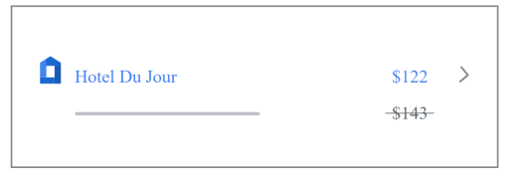
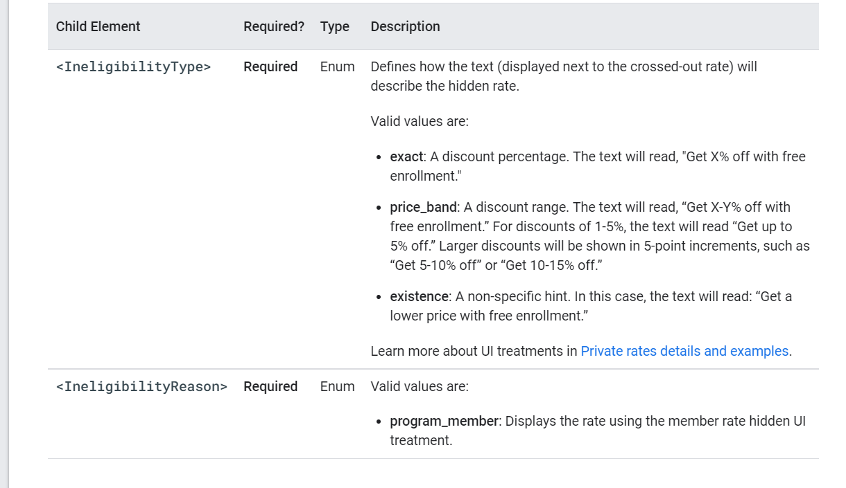
<RateIneligibility> <IneligibilityType>[exact|price_band|existence]</IneligibilityType> <IneligibilityReason>[program_member]</IneligibilityReason>
</RateIneligibility>

Slide 12
Rate Modification
Modifies the UI treatment for private rates.
The <RateModification> element appears in the following place in the rate rules XML hierarchy:
+ <RateRuleSettings> + <UserRateCondition> + <RateRule> + <UserRateCondition> + <RateIneligibility> + <RateModification>

Slide 13
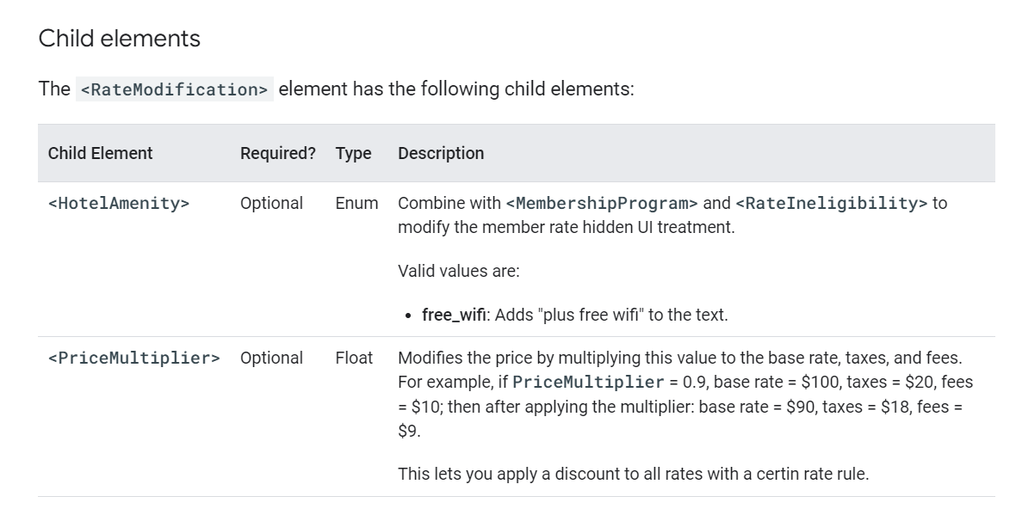
Child of Rate Modification.

Slide 14
Example
<?xml version="1.0" encoding="UTF-8"?> <RateRuleSettings> <RateRule id="membership_program"> <RateIneligibility> <IneligibilityReason>program_member</IneligibilityReason> <IneligibilityType>price_band</IneligibilityType> </RateIneligibility> <RateModification> <HotelAmenity>free_wifi</HotelAmenity> </RateModification> <UserRateCondition> <MembershipProgram>[enter program name here]</MembershipProgram> </UserRateCondition> </RateRule> </RateRuleSettings>
--------------------------------------------------------------------------------------------------------------------------------------------------------------
--------------------------------------------------------------------------------------------------------------------------------------------------------------
<?xml version="1.0" encoding="UTF-8"?> <RateRuleSettings> <RateRule id="mobile"> <RateModification> <PriceMultiplier>0.95</PriceMultiplier> </RateModification> <UserRateCondition> <UserDeviceType>mobile</UserDeviceType> </UserRateCondition> </RateRule> </RateRuleSettings>
Only Hotel amenity defined
Only price multiplier defined

Slide 15
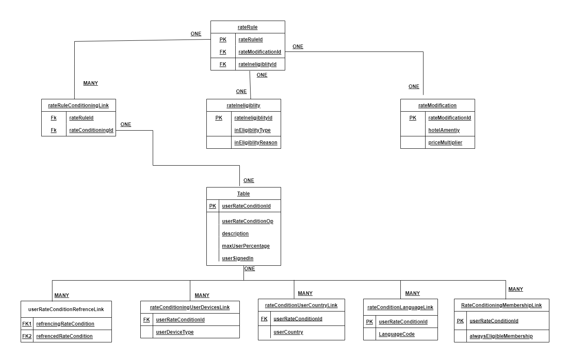
Databases ER Diagram

Slide 16
Observation
It has been observed that the RateRuleSettings can be defined in two place as per the ease ,
In method 1, the RateRuleSetting at global level
In method 2, the RateRuleSettiing can be defined in RateRule at local level.
+ <RateRuleSettings> + <UserRateCondition> + <RateRule> + <UserRateCondition> + <RateIneligibility> + <RateModification>
At global level
At Local level

Slide 17
conclusion
In my opinion it will be better to define rateRuleSettings at the top globally which will make it accessible to all rateRules and will make XML much more clean and easy to understand.

